Slide 1
CaseLoad Intensity
Wraparound Cases

Slide 2
What is Caseload Intensity and Why are we looking at It
Not all cases are equal
The number of cases you can handle will depend on their intensity level
The intensity of the case can be determined by the Child and Adolescent Needs and Strengths Assessment
The number of cases and intensity can be adjusted according to FTE level.

Slide 3
Pilot Agencies
Initial Agency-Genesis
Final Agencies-NYAP and Prestera

Slide 4
What we Learned
Allowed supervisors to review the CANS for timeliness and quality.
Easy to see who is at their caseload limit or can take more cases.

Slide 5
Active Cases
Discharges and transfers should be deleted immediately so that they do not affect your case loads. If you want to keep a history, then you should save your workbook under another name or date and then delete cases. (We will look at eliminating the exit date column)
Holds should NOT be included in your list of cases (We are currently discussing)

Slide 6
Workbook Set-up
· There should be a tab for each facilitator to be added (e.g., WF_name).
· Double click on a tab and then you can type in the name of the facilitator to replace the placeholder. You can simply ignore tabs that are not needed. They will not impact intensity calculations.
· 30 tabs have been provided. If you need to add more tabs, click on the blank worksheet tab. Go to the arrow in the upper left corner and click. Copy, then go to the plus sign at the bottom of the page to add a new tab. Go to the arrow in the upper left corner of that tab and click and paste.
· Update the "date updated" every time you make changes to case information (row 21)

Slide 7
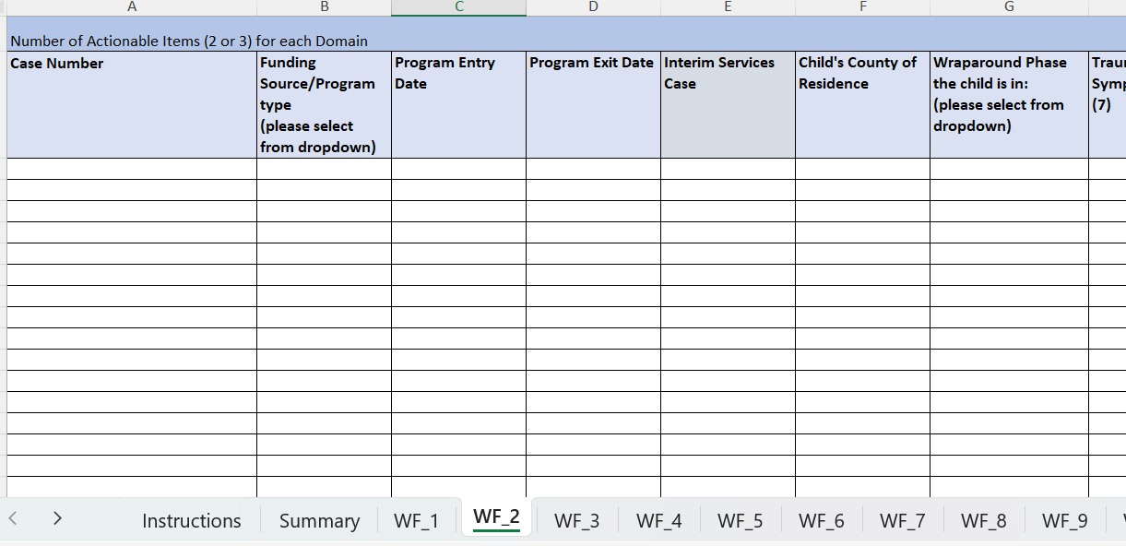
THE WORKBOOK
Double Click tab to enter name or number

Slide 8
Case List
· The Case List for each facilitator can come from a couple of places. It can either come from the agencies’ own list that they maintain or from the WV CANS System.
· List all cases in Column A using a case number that can be tracked within your organization's record keeping.
· List the funding source for each case by selecting from the dropdown in Column B.

Slide 9
Workbook Set-up
· List the program entry date and exit date (if applicable) by typing a valid date into Column C and D. Cases should be removed from the list upon exit to allow for accuracy in caseload calculations and planning.
· Select Yes or No to indicate if the case is an interim services case using Column E. Adjust as needed if the case changes status.
· Select the county of residence for the child in Column F.
· List the current wraparound phase each case is in by selecting from the dropdown in Column G.

Slide 10
THE WORKBOOK
Use a number that you can track. Do not use names.

Slide 11
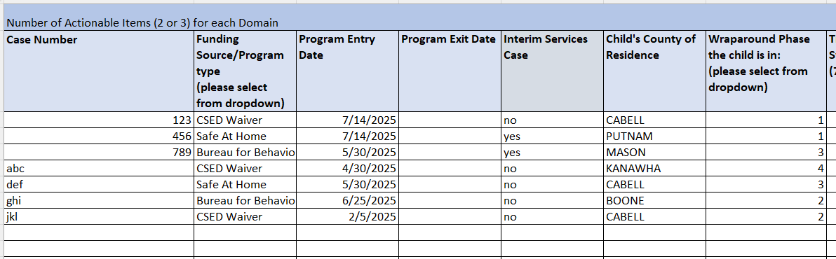
THE WORKBOOK
Phase: 1=Engagement 2=Planning 3=Implementation 4=Transition

Slide 12
Actionable Items
Actionable Items are 2’s and 3’s on the CANS.
We are looking at 4 Domains: Trauma Symptoms, Life Functioning, Behavioral, and Emotional, Risk Behaviors
New Cases that do not have a CANS completed yet, should be listed and given 1 actionable item in each Domain.

Slide 13
Number of 2’s and 3’s for each domain. Don’t add numbers together.
THE WORKBOOK

Slide 14
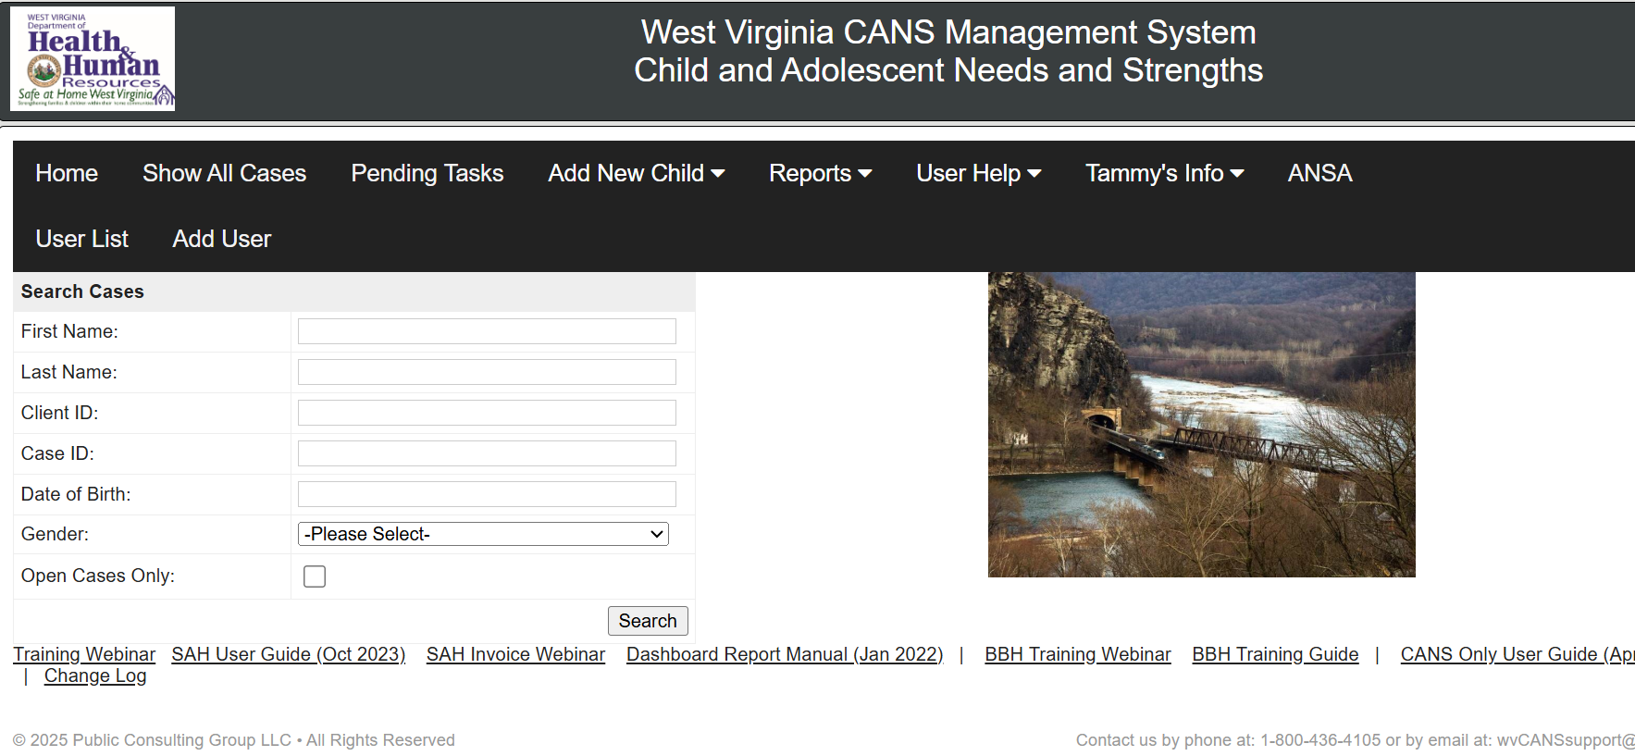
THE WORKBOOK
Go to Home Page

Slide 15
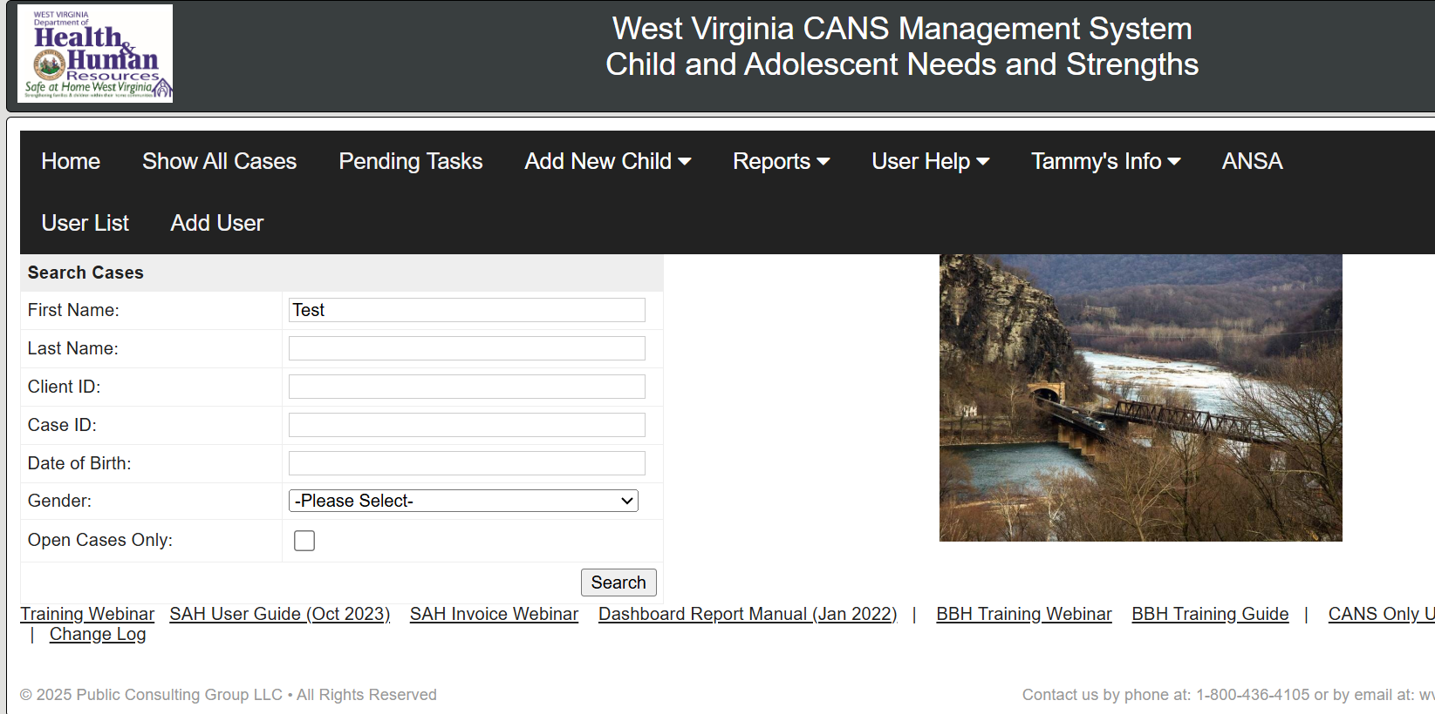
THE WORKBOOK
Enter Name or ID Number

Slide 16
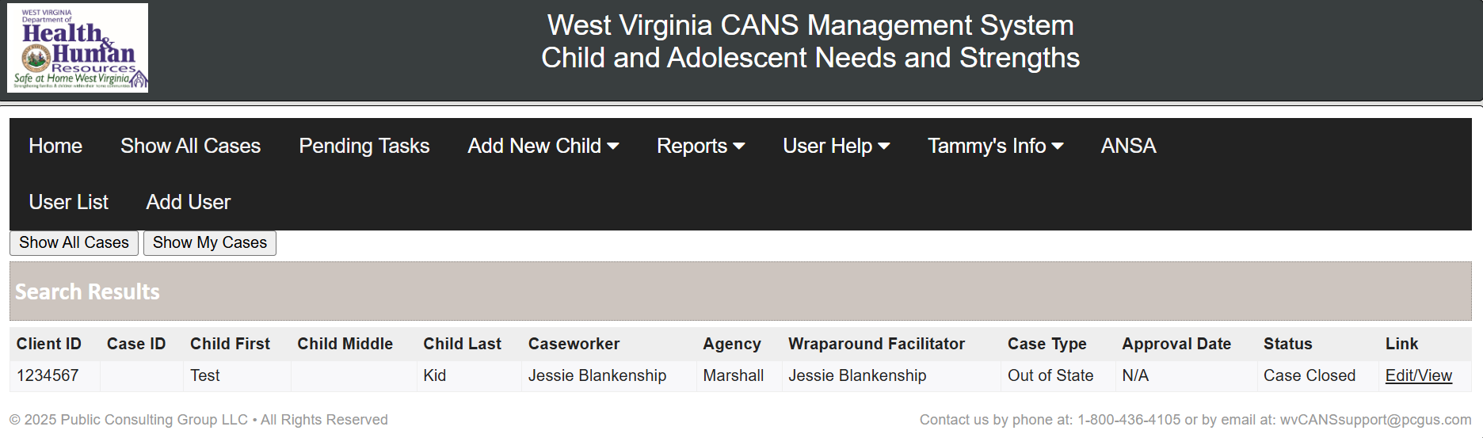
Click on Edit/View

Slide 17
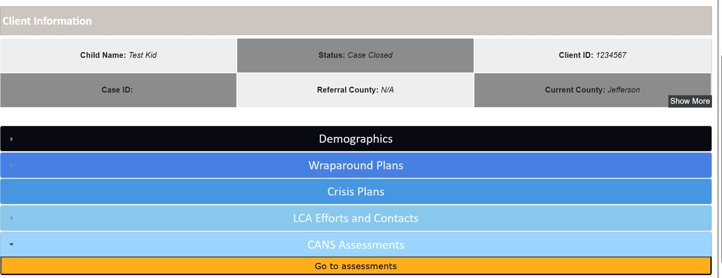
Click on CANS Assessments and then click on Go to Assessments

Slide 18
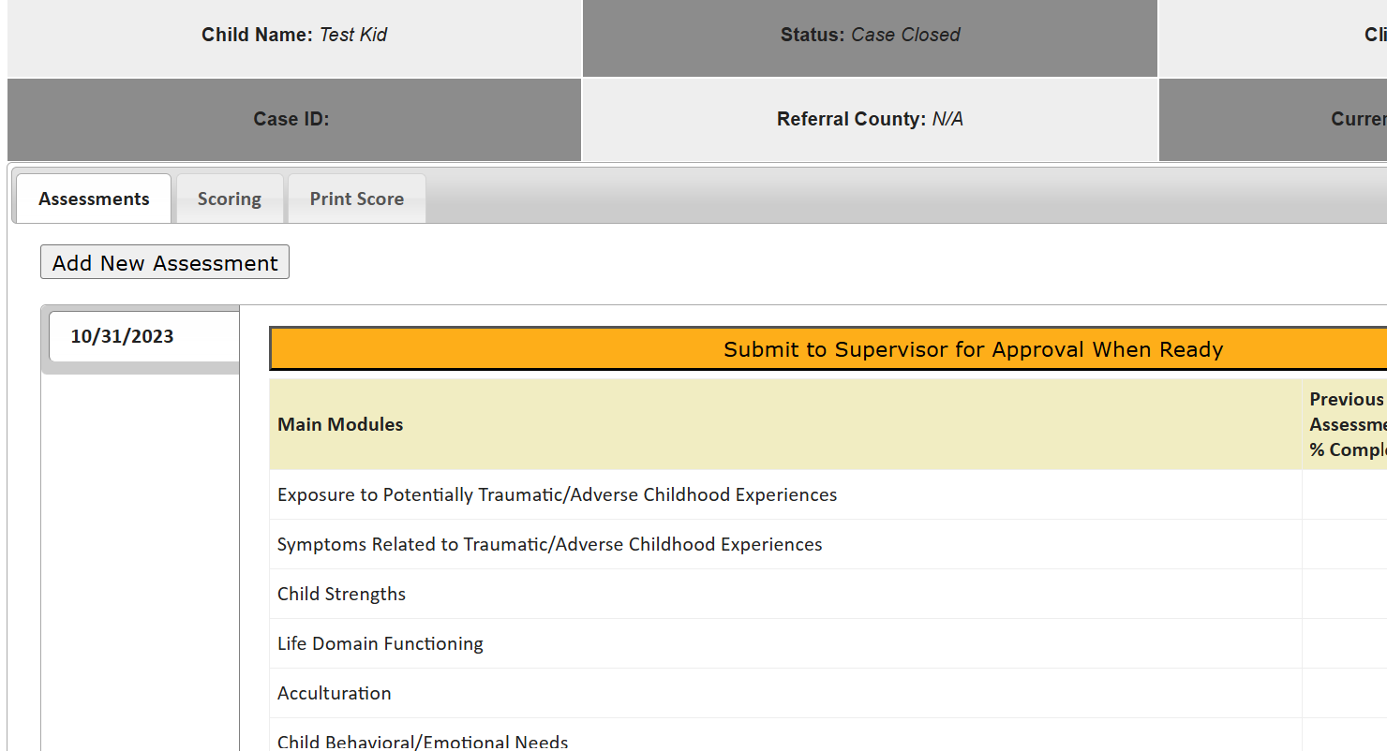
After you select the CANS you want, click on scoring.
Select the Most Recent CANS.

Slide 19
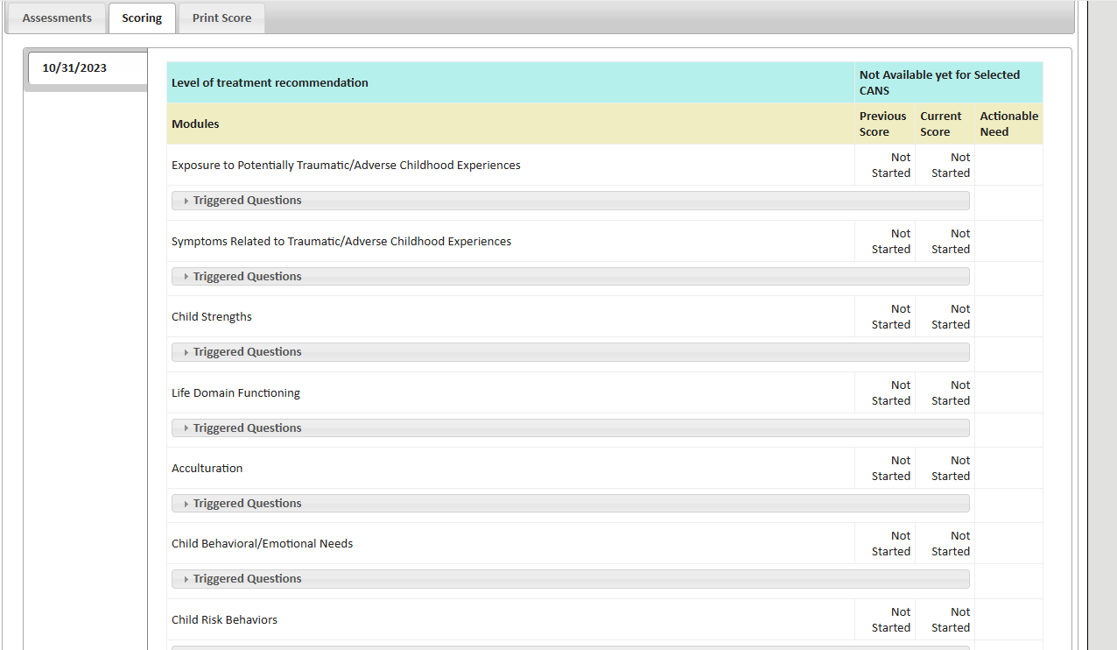
3
1
2
4
0
3
2

Slide 20
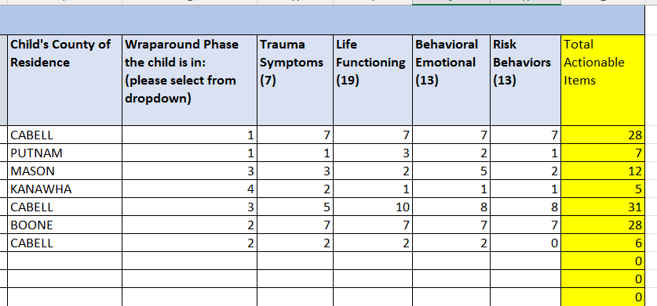
THE WORKBOOK

Slide 21
Intensity Score
Look at the green cells which point to caseload results. That will give you the intensity level per individual and represented considering the facilitators full time equivalency status.
Cases are weighted and a score should never go over 15.
The FTE ratio adds additional consideration as to a facilitators availability.
The score does not indicate the number of cases you have or should have. That depends on the intensity of all current and future cases.

Slide 22
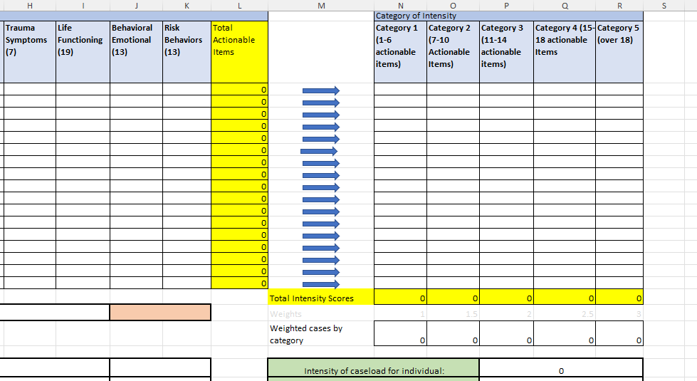
THE WORKBOOK
Tabulated for You

Slide 23
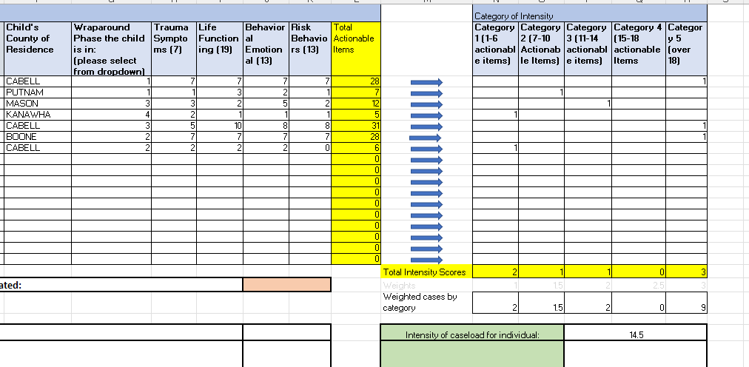
THE WORKBOOK
This person would not be able to take more cases because they are close to the cut off intensity score

Slide 24
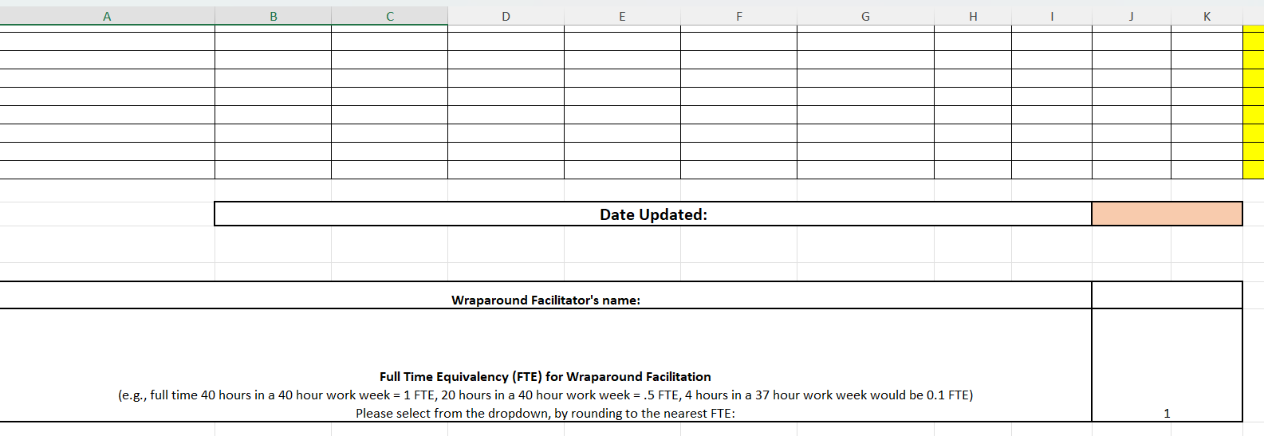
THE WORKBOOK
FTE is important and can change the intensity score

Slide 25
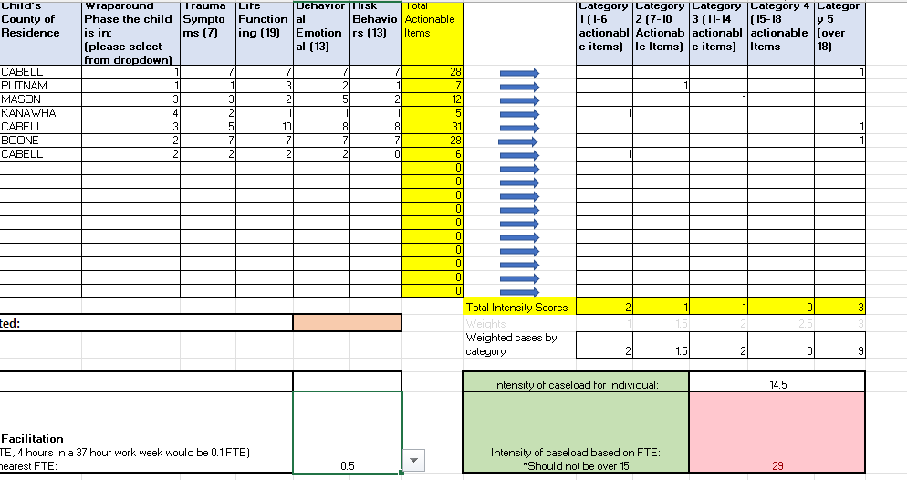
THE WORKBOOK
This person has too many case if they are only working part-time

Slide 26
Summary Tab
In the Summary tab, look at the green cells which point to the average caseload results for all facilitators reported for the agency (with a non-zero caseload).
This average is represented considering the facilitators full time equivalency statuses; the FTE ratio adds additional consideration as to a facilitators availability.
Cases are weighted based on intensity and average score for agency should never go over 15.
NOTE: If additional tabs are added beyond what is included originally, these will not automatically be calculated in the summary.

Slide 27
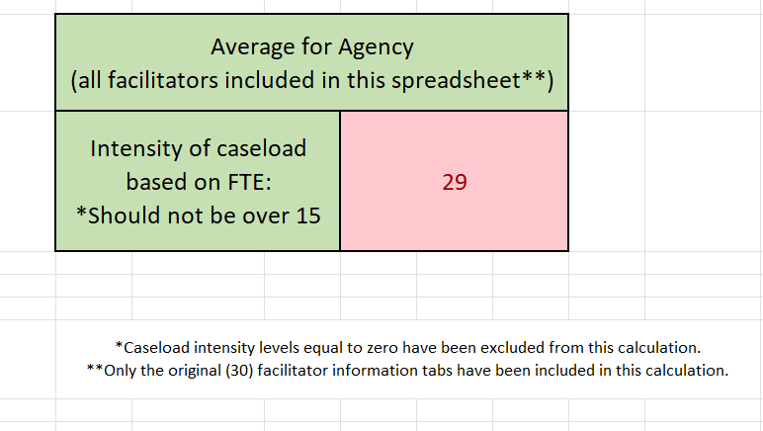
Summary Tab

Slide 28
Due Dates
Best practice is to update daily. This tool is for you and the state so it is important to update regularly.
September 5, 2025
December 5, 2025
March 6, 2026
June 5, 2026
September 4, 2026

Slide 29
Moving Forward
Data will also be used by the state to track workforce gaps. This will be sent to designated staff officials every quarter or as requested
CANS accuracy is critical! We recommend attending the Child and Adolescent Needs and Strengths for Wraparound Providers Training.
CANS introductory training for wraparound. This is scheduled monthly.

Slide 30
Resources
Caseload Intensity-Tammy Pearson-tpearson@marshall.edu
CANS Training for Wraparound Providers-Heather Sullivan-sullivanhe@masrahll.edu OR Gabbi Lambert- lambert224@marshall.edu
https://marshall.az1.qualtrics.com/jfe/form/SV_cROcnsHOaDt4rf8
TCOM/Wraparound Fidelity Staff /WV CANS System-
Lydia Shaw –cartwright15@marshall.edu

Slide 31
THANK YOU
Tammy Pearson
tpearson@marshall.edu

